Slide 1
PRINCE2 Project Management
Moniruzzaman Bhuiyan
BSc (Hons), MSc(DU & UK), MBCS, MCP, PRINCE2
Software Practitioner and Researcher,
Institute of Information Technology
University of Dhaka
mb@du.ac.bd | monirb@live.com
www.tinyurl.com/monirb

Slide 2
PRINCE2 - PRojects IN Controlled Environments
PRINCE2 is a project management methodology created in the early 1990s which was adopted by the UK Government for all IT projects.
PRINCE2 is widely used in public and private sectors and has become the de facto standard for project management.

Slide 3
PRINCE2 - Projects IN Controlled Environments
PRINCE2 covers organization, management and control of projects.
It provides a tailored and scalable method for the management of all types of projects. Each process is defined with it’s own key inputs and outputs, together with the specific objectives and activities to be performed.

Slide 4
PRINCE2 - Projects IN Controlled Environments
PRINCE2 describes the project’s manageable stages, which allows efficient control of resources and regular progress-monitoring throughout the project.
Project planning using PRINCE2 is product-based. This means project plans are aimed at delivering results (not just about planning when the various activities on the project will take place).

Slide 5
PRINCE2 - PRojects IN Controlled Environments
Integral to PRINCE2 method is the business case.
The business case describes the organization’s justification, commitment and rationale for the project's itself. The business case has to be reviewed on a regular basis to ensure the business objectives are still being met (especially important when these objectives can change over time).

Slide 6
PRINCE2 - PRojects IN Controlled Environments
The method (like the ITIL Framework for IT process management of infrastructure environments) provides a common language across all parties (including external third parties).
PRINCE2 can be used for a wide variety of projects.

Slide 7
What is Project (Management)?
Competition is rapidly becoming time-based as well as cost-based.
A project is done only once, whereas most jobs are on going or repetitive, & managing one-time jobs is different from managing on going ones.
A project as a problem scheduled for solution
Unique series of actions designed to accomplish a unique goal within specific time and cost limitations

Slide 8
Project ….
Project management: The planning, scheduling, and controlling of project activities to meet project objectives.
Human factors include:
Leadership
Negotiation
Team building
Motivation
Communication
Decision making

Slide 9
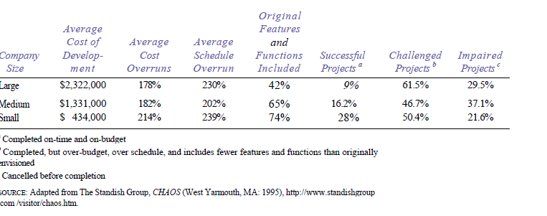
Project fails

Slide 10
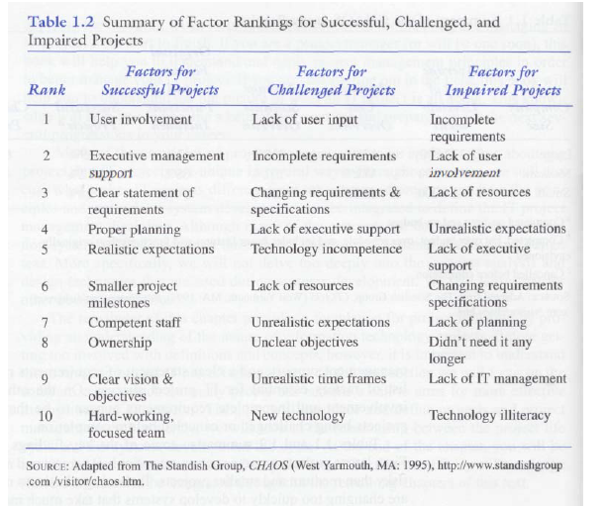
Project fails

Slide 11
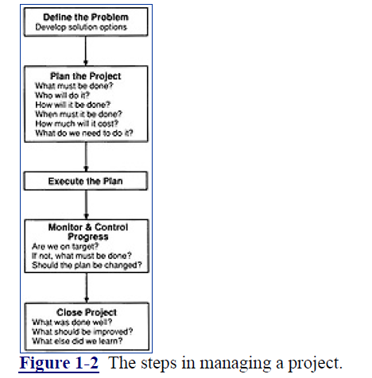
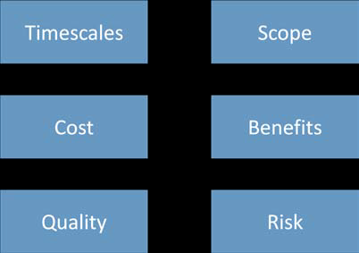
Steps & variables

Slide 12
YOU

Slide 13
Why PRINCE2
PRINCE2 is a method that deals with the planning, delegation, monitoring and control of all six project variables which are, as we already know: Timescales, Costs, Quality, Scope, Benefits and Risks. The PMBok refers to these 6 variables as the 6 competing Project Constraints.
There are many advantages to using a Project Management method; this also applies to PRINCE2. I will list a few of them here.

Slide 14
Benefits
Benefit 1: Best Practice:
Benefit 2: PRINCE2 can be applied to any kind of project.
Benefit 3: PRINCE2 provides a structure for roles and accountability
Benefit 4: PRINCE2 is product-focused
Benefit 5: PRINCE2 uses Management by Exception.
Benefit 6: PRINCE2 continuous assessment
Benefit 7: PRINCE2 has a well-defined structure
Benefit 8: PRINCE2 promotes learning and a continual improvement mindset
More ……..

Slide 15
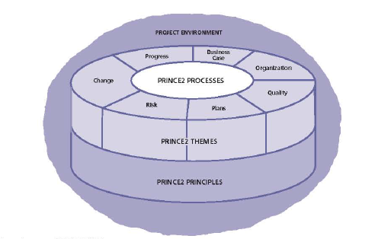
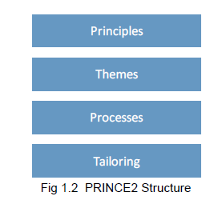
PRINCE2 – overview

Slide 16
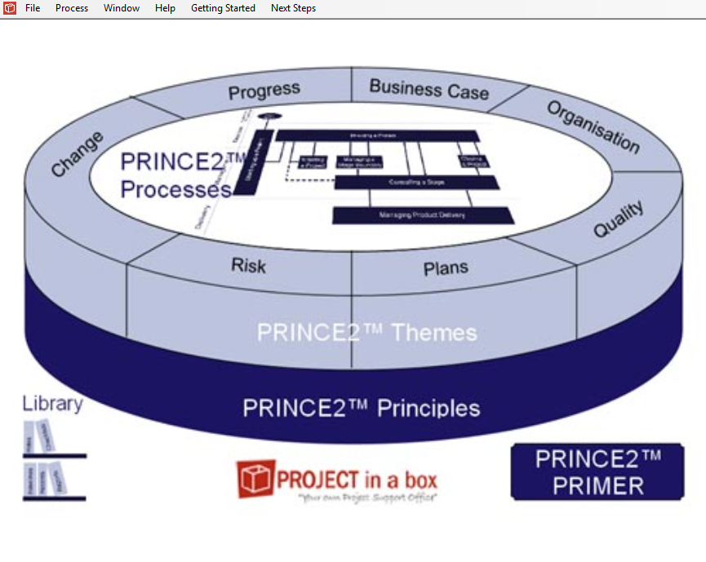
Tools
Ms Word
One Note
Project In
A Box

Slide 17
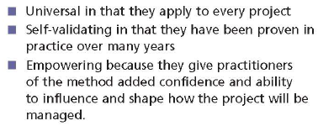
Principles
Principles provide a framework of good project practice for those involved in a project
PRINCE2 is principles based

Slide 18
7 Principles
There are seven principles and they can be summarized as:
Continued business justification
Learn from experience
Define roles and responsibilities
Manage by stages
Manage by exception
Focus on products
Tailor to suit the project environment
To sum it up, think of principles as guides for good practice

Slide 19
First 3 principles
Continued business justification
Learn from experience
Define roles and responsibilities

Slide 20
Last 4 Principles
Manage by stages
Manage by exception
Focus on products
Tailor to suit the project environment

Slide 21
Review
&
QA

Slide 22
PRINCE2 – Themes
Themes are the parts of the project that need to be continually addressed throughout the project lifecycle.
This next section will look at the seven defined themes in PRINCE2.

Slide 23
PRINCE2 – Themes
Seven themes are
Business case
Organization
Quality
Plans
Risk
Change
Progress

Slide 24
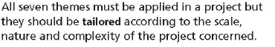
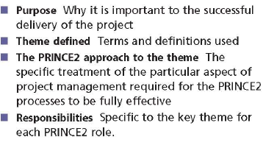
PRINCE2 – Themes
Applying
Format

Slide 25
Business Case
Introduction to Business Case Knowledge
What happens in the real world?
The Business Case knowledge provided by PRINCE2
What does a Business Case do for the project?
How to best describe what you get from a project?

Slide 26
Business Case
Different types of Business Case
The path to creating the Business Case
Step 1: Develop the Business Case
Step2: Verify the Business Case
Step 3: Maintain the Business Case
Step 4: Confirm the Benefits
The Benefits Review Plan
Example of a Poor Business Case

Slide 27
Business Case
The Contents of a Business Case
Executive Summary
Reasons
Business Options
Expected Benefits and expected dis-benefits
Timescale/Costs
Investment Appraisal
Major Risks
Example of Business Case for a CRM Project
Appraisal
Business Case: Who is responsible for what? Corporate or Program Management , Senior User , Executive , Senior Supplier, Project Manager, Team Manager , Project Support

Slide 28
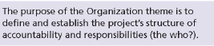
PRINCE2 – Organization
Introduction to Organization Knowledge
What happens in the real world?
Organization Definitions
Project & Programs

Slide 29
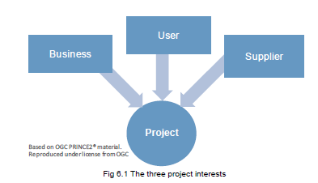
PRINCE2 - Organization cont…
Three Project Interests / 3 Stakeholder Categories

Slide 30
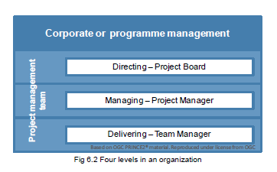
PRINCE2 - Organization cont…
The four levels of Organization
Project Board
Project Assurance: User, Business & Supplier

Slide 31
PRINCE2 – Organization cont…
The Change Authority Role
The Project Manager Role
Team Manager & Project Support
Project Support and centre of excellence
Project Manager and the Project Organization
Stakeholder Engagement

Slide 32
PRINCE2 - Organization cont…
The Communication Management Strategy
Responsibilities for Organization Theme
Corporate or Program Management, Senior User, Executive, Senior Supplier, Project Manager, Team Manager, Project Support

Slide 33
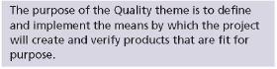
PRINCE2 - Quality
Introduction to Quality Knowledge
What happens in the real world?
The Quality Knowledge provided by PRINCE2

Slide 34
PRINCE2 – Quality
Quality Lingo
Quality is the concept that we use to discuss the suitability of a Product, for the purpose that it was designed or developed for.
In a project environment we use quality to assess the suitability of products – but in regards to the context of the whole project, not just the part of the project that the product was created under.

Slide 35
PRINCE2 – Quality cont…
Introduction to the PRINCE2 Approach to Quality:
Quality Planning & Quality Control
Part 1: Quality Planning Introduction
Quality Planning: Integrated into the Starting Up of a Project (SU) process; the way that the quality system will be used will be in the Project Initiation Document and therefore it will form part of each Stage Plan
Quality Plan Steps – Quality Audit Trail
The Customer’s Quality Expectations
Acceptance Criteria
The Project Product Description
Project Product Description Example
The Quality Management Strategy Document
Product Descriptions
Quality Register

Slide 36
PRINCE2 – Quality cont…
Part 2: Quality Control Introduction & Quality Methods
Checking the quality of products produced matches the quality expectations and was reached by utilizing the Quality system.
Quality records, approval records and acceptance records
The PRINCE2 Quality Review Technique

Slide 37
PRINCE2 – Quality cont…
Responsibilities
Corporate or Program Management
Senior User
Executive
Senior Supplier
Project Manager
Team Manager
Project Support
Quality Summary

Slide 38
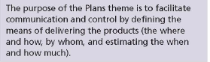
PRINCE2 – Plans
Introduction to Plans Knowledge
What happens in the real world?
The Plans Knowledge provided by PRINCE2

Slide 39
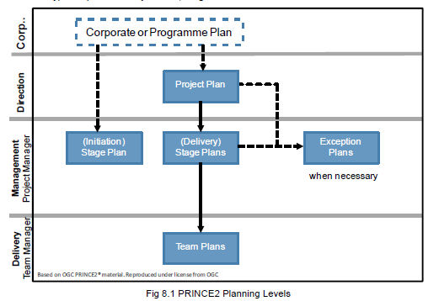
PRINCE2 – Plans cont…
Plans Lingo
A project plan answers these questions: Why, What, Who, When & How much
Three levels of a Plan

Slide 40
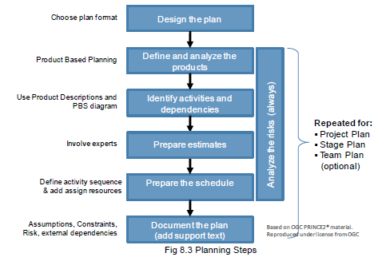
PRINCE2 – Plans cont…
The Path to Planning
The Project Plan, Stage Plan and Team Plan
The Exception Plan – Introduction

Slide 41
PRINCE2 – Plans cont…
The PRINCE2 Planning Steps
Step 1: Design the Plan
Step 2: Product-Based Planning Introduction
Project Product Description: Describing the main product.
Product breakdown structure: Listing all products than need to be created. Product-Based Planning - Example
Product Description for each product.
Product Flow Diagram: Showing product flow and interdependencies.
Step 3: Identify Activities and Dependencies

Slide 42
PRINCE2 – Plans cont…
Step 4: Prepare Estimates
Step 5: Prepare the schedule
Document the Plan
Examples of Risks in Planning
The Product Checklist
Responsibilities
Corporate or Program Management , Senior User , Executive , Senior Supplier, Project Manager, Team Manager , Project Support
Summary

Slide 43
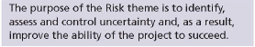
PRINCE2 – Risk
PRINCE2 defines risk as: ‘The chance of exposure to the adverse consequences of future events.’
The key role of the Project Manager is the overall management of risk.
Purpose of the knowledge in the Risk Theme

Slide 44
PRINCE2 – Risk Cont….
Introduction to Risk Knowledge
What happens in the real world?
Risk Lingo
Another definition is:
Risk is an uncertain event that if it occurs, will have a positive or negative effect on a project objective
What is Risk Management

Slide 45
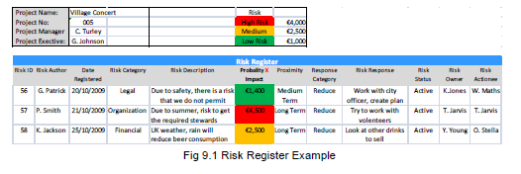
PRINCE2 – Risk Cont….
The Management of Risk Method & Risk Context
The Risk Register - Risk History

Slide 46
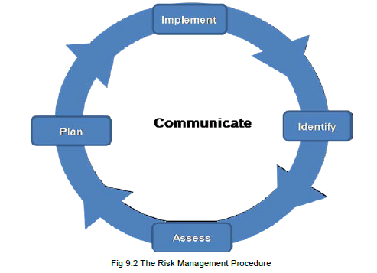
PRINCE2 – Risk cont…
The Risk Management Procedure Introduction
Step 1: Identify
How to Express
the Risk
Step 2: Assess Risk
Step 2: Assess Risk: Estimating

Slide 47
PRINCE2 – Risk cont…
Step 2: Assess Risk – Evaluate
Step 3: Plan is about Planning the Responses
Plan the Responses to Threats
Plan the Responses to opportunities
Step 4: Implement the Responses
Step 5: Communicate

Slide 48
PRINCE2 – Risk cont…
What is a Risk Budget?
Risk Roles and Responsibilities
Corporate or Program Management , Senior User , Executive , Senior Supplier, Project Manager, Team Manager , Project Support
Risk Summary

Slide 49
PRINCE2 – Change
Everything changes! Yes, even our well controlled and expertly planned Project products and their requirements!
PRINCE2’s focus on Change Control centres on any changes to products (i.e. the primary deliverable component of a stage).

Slide 50
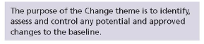
PRINCE2 – Change
Introduction to Change Knowledge
What happens in the real world?
Purpose of knowledge in the Change Theme

Slide 51
PRINCE2 – Change
Change Lingo
Configuration Management:
Configuration Management is the technical and administrative activity concerned with the creation, maintenance and controlled change of the configuration of a product.
The PRINCE2 Approach to Change

Slide 52
PRINCE2 – Change cont…
Configuration Management Strategy
How to prioritize issues & track severity
Change Authority and Change Budget
Management Products used by the Change Theme
The Configuration Management Procedure

Slide 53
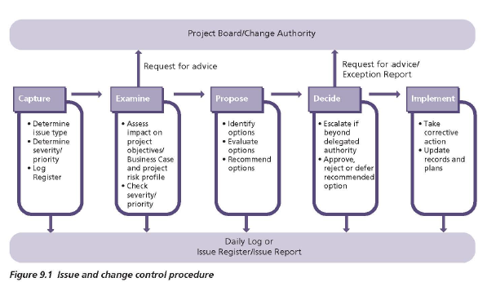
PRINCE2 – Change cont…
Issue and Change Control Procedure

Slide 54
PRINCE2 – Change cont…
Capture: Issue and Change Control Procedure
Examine: Issue and Change Control Procedure
Propose

Slide 55
PRINCE2 – Change cont…
Decide
Implement
Roles and Responsibilities
Corporate or Program Management , Senior User ,
Executive , Senior Supplier, Project Manager,
Team Manager , Project Support
Summary

Slide 56
PRINCE2 – Progress
Stages are a collection of activities and products whose delivery is managed as a single unit. Each project is broken into stages.
The final number and size of each stage is dependent on the project.

Slide 57
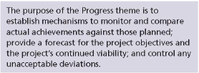
PRINCE2 – Progress
Introducing progress
What happens in the real world?
Purposes
Purpose of the information in the Progress Theme

Slide 58
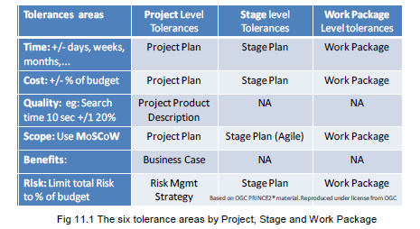
PRINCE2 – Progress
Progress, Progress Controls, Exceptions and Tolerances
When are the Six Tolerances set?

Slide 59
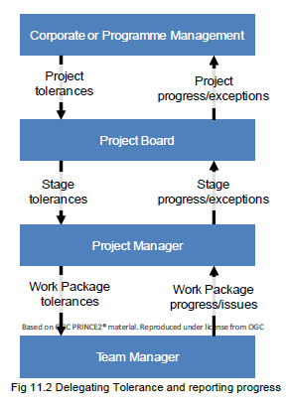
PRINCE2 – Progress cont…
What is the PRINCE2 Approach to Progress?
What are the 3 Project Board Controls?

Slide 60

PRINCE2 – Progress cont…
Use of Management Stages for Control
What are Technical Stages?
Event-Driven and Time-Driven Controls
How does the Project Manager review progress?

Slide 61
PRINCE2 – Progress cont…
Capturing and reporting lessons
Reports used to Report Progress
What is Raising Exceptions?
Progress Responsibilities
Corporate or Program Management , Senior User ,
Executive , Senior Supplier, Project Manager,
Team Manager , Project Support
Summary

Slide 62
Review
&
QA

Slide 63
PRINCE2 - Process
Introduction to Processes
The PRINCE2 Processes: The 7 PRINCE2 process are:
Starting Up a Project
Initiating a Project
Directing a Project
Controlling a Stage
Managing Product Delivery
Managing a Stage Boundary
Closing a Project

Slide 64
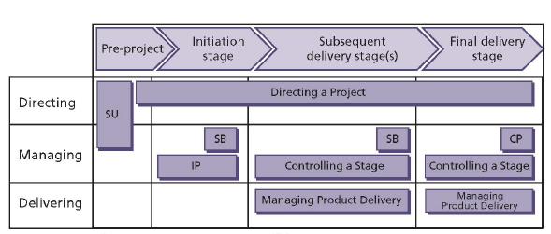
PRINCE2 – Processes!
Pre-Project
Initiation Stage
Next Stage or Stages after the Initiation Stage

Slide 65
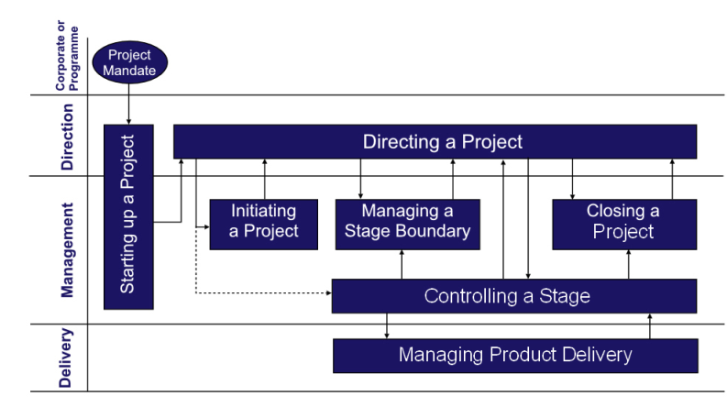
The PRINCE2 Process Model Introduction

Slide 66
PRINCE2 – Processes!
This next sections will look at the seven defined processes that comprise the PRINCE2 Framework.
Some processes are labeled as “start up”, others as “ongoing”.
The “Directing a Project” process is ongoing, but it is also more strategic in nature. It is considered to be the ‘first’ process, but is a continuum of activities that is required throughout the life of the project.

Slide 67
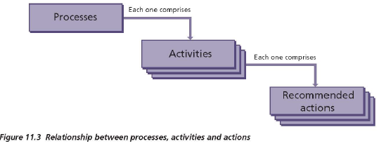
PRINCE2 – Processes!
Each process structure
Purpose
Objectives
Context
Activities

Slide 68
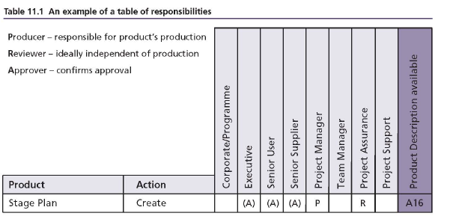
PRINCE2 – Processes!
Activity and responsibility in each process products(output)

Slide 69
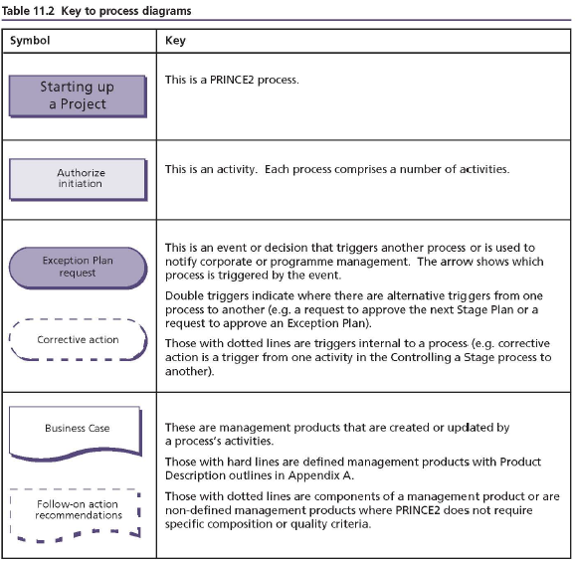
PRINCE2 – Processes!
Key to process diagram

Slide 70
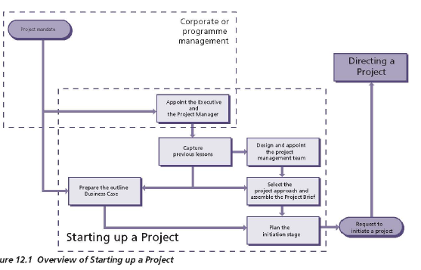
PRINCE2 – Processes – Starting Up!
Logically the first process defined by PRINCE2 is SU = Starting up a Project.
This process can be considered as ‘pre-project
Introduction

Slide 71
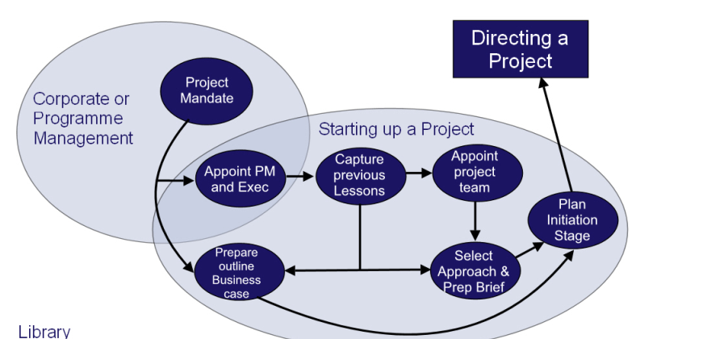
PRINCE2 – Processes – Starting Up!
Introduction

Slide 72
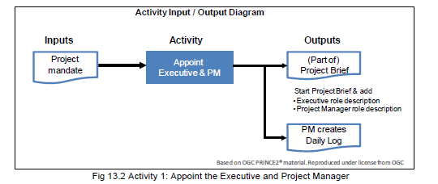
PRINCE2 – Processes – Starting Up!
Purpose & Objective of the Starting Up a Project Process
Activities Introduction activities’ are :
Appoint the Executive and the Project Manager
Capture Previous Lessons

Slide 73
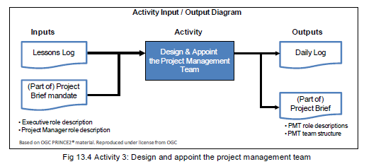
PRINCE2 – Processes – Starting Up!
Design and appoint the Project Management Team
Outline Business Case

Slide 74
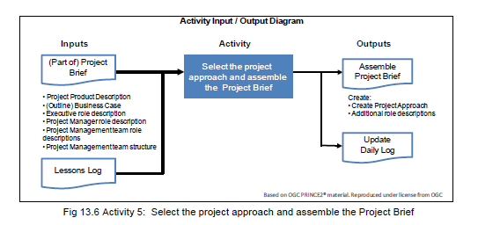
PRINCE2 – Processes – Starting Up!
Select Project Approach and Assemble Project Brief
Plan the Initiation Stage
Summary of Activities

Slide 75
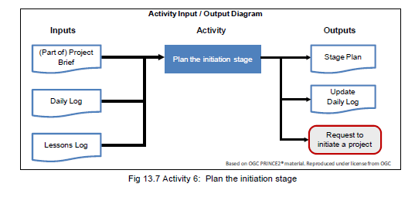
PRINCE2 – Processes – Starting Up!
Plan the Initiation Stage
Summary of Activities

Slide 76
PRINCE2 – Processes – Directing A Project
This process (DP) is more of a continuum of activities that are required throughout the life of the project. It begins after the project Start Up (SU), and runs through until the completion of the Project (refer CP – Closing a Project).
The Board is not involved with the day-to-day management of the project.

Slide 77
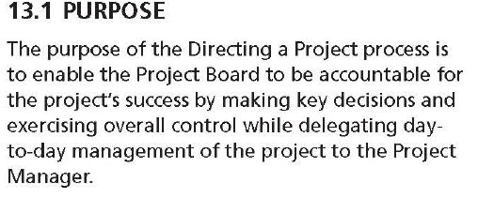
PRINCE2 – Processes – Directing A Project
The actual project authorization comes from the Project Board. The decision is made in regard to the strength of the business case, balanced against the time, cost and other relevant organization strategies.

Slide 78
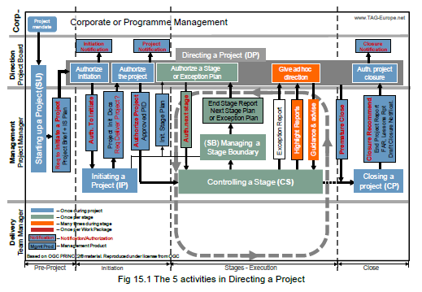
PRINCE2 – Processes – Directing A Project

Slide 79
PRINCE2 – Processes – Directing A Project
There are 5 activities within the Directing a Project Process; they are:
Authorizing Initiation
Authorizing the project
Authorizing a Stage or Exception Plan
Giving ad hoc direction
Authorizing project closure
The board will base its decision to authorize the project initiation, based on the Initiation Stage Plan, from the SU process.

Slide 80
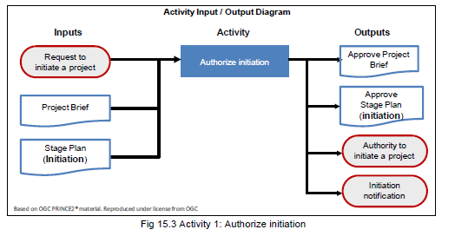
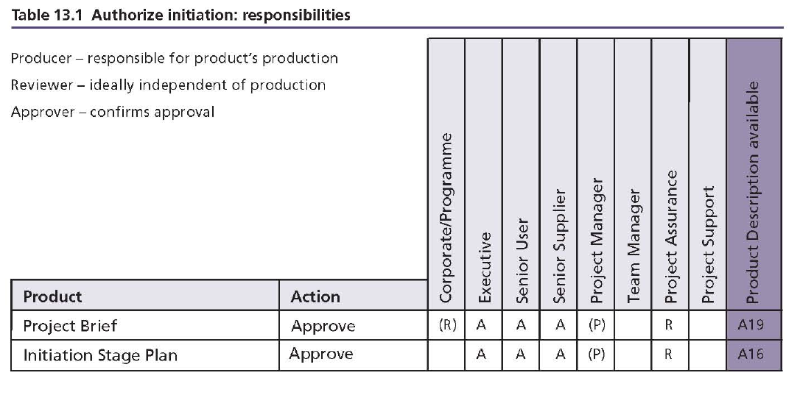
PRINCE2 – Processes – Directing A Project
Activity-1
Others

Slide 81
PRINCE2 – Processes – Initiating A Project
To date, the real work of the project has not begun.
The activities prior to this point have been focused on making sure that the project was not just a reaction to a temporary issue.

Slide 82

PRINCE2 – Processes – Initiating A Project
Eight activities which are:
• Preparing the Risk Management Strategy,
• Preparing the Configuration Management Strategy,
• Preparing the Quality Management Strategy,
• Communication Management Strategy
• Setup of Project Controls.
• Creating the Project Plan.
• Refining the Business Case.
• Lastly, assembling the Project Initiation Documentation.

Slide 83
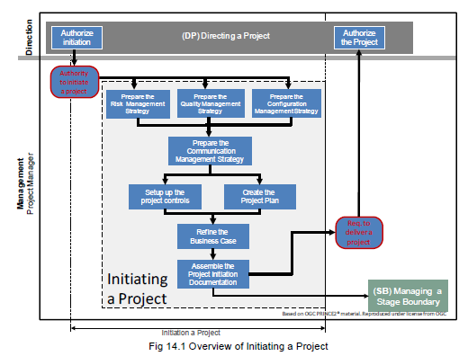
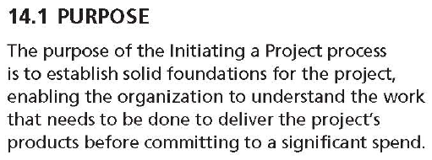
PRINCE2 – Processes – Initiating A Project

Slide 84
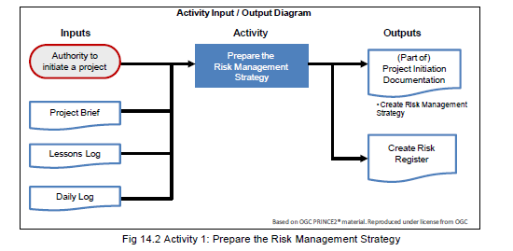
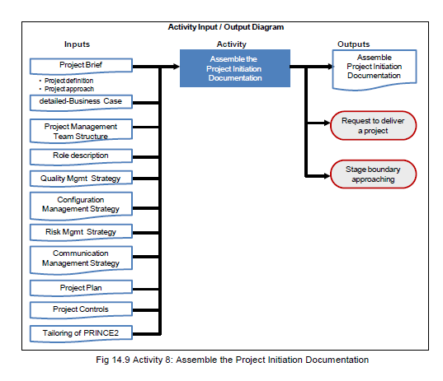
PRINCE2 – Processes – Initiating A Project - Activities

Slide 85
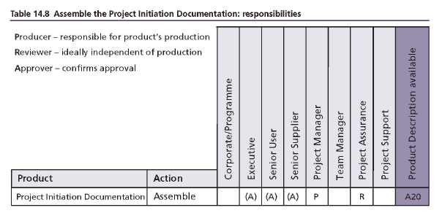
PRINCE2 – Processes – Initiating A Project

Slide 86
PRINCE2 – Processes – Controlling a Stage
Now that we have defined the “products” that are to be delivered, we need to ensure that we can actually deliver these products. Saying we can is one thing – actually doing it requires control disciplines.
It requires discipline to ensure that resources don’t get side tracked/distracted and it requires controls to ensure that the plan, along with its requisite budgets and time constraints are adhered to.

Slide 87
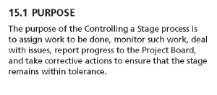
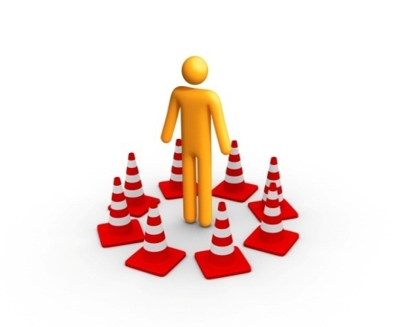
PRINCE2 – Processes – Controlling a Stage
8 activities, which are divided in
Three Work Package activities,
2 Monitoring and Reporting activities, and
Three Issues activities.

Slide 88
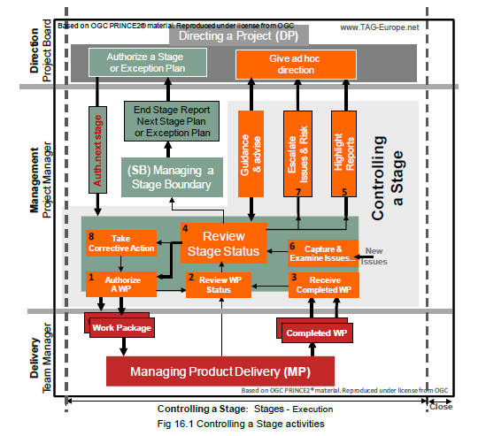
PRINCE2 – Processes – Controlling a Stage

Slide 89
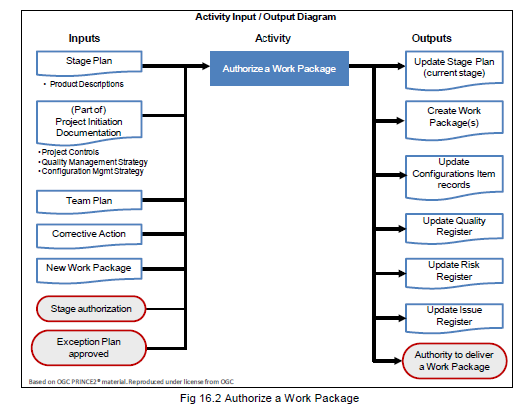
PRINCE2 – Processes – Controlling a Stage
Sample activity
Other activities

Slide 90
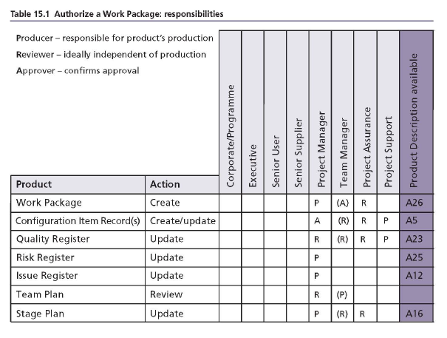
PRINCE2 – Processes – Controlling a Stage
Sample roles of an activity
Others

Slide 91
PRINCE2 – Processes – Managing Product Delivery
Someone has to do the work!
We refer to the “someone” as third party Suppliers.
We should also not get trapped in thinking that third party suppliers are only those external to the actual business. The Project generally calls upon internal staff to perform specific activities for the project – these staff then also become “third party suppliers”.

Slide 92

PRINCE2 – Processes – Managing Product Delivery
3 activities which are:
Accepting a Work Package
Executing a Work Package
Delivering a Work Package

Slide 93

PRINCE2 – Processes – Managing Product Delivery

Slide 94


PRINCE2 – Processes – Managing Product Delivery
Sample activity & responsibility

Slide 95
PRINCE2 – Processes – Managing Stage Boundaries
The Managing Stage Boundaries (SB) process is all about building in the line breaks, so that we can check the project is still on track and heading in the right direction to deliver the benefits.
If it is not, then we can change direction or stop the project – without inflicting any more damage on the organization (principally cost).

Slide 96

PRINCE2 – Processes – Managing Stage Boundaries
5 activities within the Managing a Stage Boundary and they are:
Planning the next stage
Update the Project Plan, with information from current & next stage.
Update the Business Case, since cost, time and risk will most likely have changed.
Reporting Stage End and Creating the End Stage Report.
“Producing an Exception Plan”.

Slide 97

PRINCE2 – Processes – Managing Stage Boundaries

Slide 98


PRINCE2 – Processes – Managing Stage Boundaries
Sample activity and Responsibility

Slide 99
PRINCE2 – Processes – Closing a Project
By definition a project has to end.
A clear end to a project will prevent spiralling costs and a perpetual merry-go-round effect. There can still be some incomplete activities at the end of a project – provided they are noted.

Slide 100


PRINCE2 – Processes – Closing a Project
Five activities in the Closing a Project Process that are performed by the Project Manager, and they are:
Preparing planned closure or
Prepare premature closure
Handover of products
Evaluating the project
Recommending project closure

Slide 101

PRINCE2 – Processes – Closing a Project

Slide 102


PRINCE2 – Processes – Closing a Project
Sample Activity and Responsibility

Slide 103
End of Process
Review
QA

Slide 104
Tailoring PRINCE2
What is Tailoring?
General Approach to Tailoring
What to change when tailoring
Working in a Program Environment
Tailoring the Themes of Quality, Plans, Risk, Change & Progress

Slide 105
Tailoring PRINCE2
Tailoring Processes & Management Products
Project Scale – Simple Projects
Tailoring: Commercial Customer/Supplier Environment
Tailoring: Project Type

Slide 106

Libraries
Roles
Checklist
Baselines
Records
Reports

Slide 107
Summary
777

